Slide 1

Induction to Product Testing
September 2015
© 2014 Ipsos. All rights reserved. Contains Ipsos' Confidential and Proprietary information and may not be disclosed or reproduced without the prior written consent of Ipsos.

Slide 2



1. Understanding and Using Product Testing

Slide 3
The Main Problem Types
Typically used after the exploratory & early developmental stages, when a final marketing mix has to be decided …
Existing Product Improvement
(including re-launch)
New Product Development
(Including New Variant)
Problem Type
Competitor Benchmarking
VIP
Value Improvement

Slide 4
Product Testing Designs
Comparative Designs
Design | Monadic | Sequential Monadic | Paired Comparison for VIP
What It Is | Respondent tries and evaluates only one product. | Respondent evaluates a series of products and evaluates each separately without direct comparison. | Respondent evaluates the current product and the prototype separately, as well as a direct comparison.
When To Use | Single product evaluation represents a more natural environment. Testing a novel or unfamiliar product. | Limited sample resources or low incidence. Interest in studying context or order effect. | For Final Stage VIP tests
Type Of Questions | “Absolute measurements” (without any comparison references). | “Absolute measurements”. Overall preference/ ranking can be added after final evaluation. | “Absolute measurement” on Overall Opinion Preference questions on overall performance and 2 – 3 key attributes .
Design Comments | Each product is evaluated by an independent sample then the results evaluated against each other. | Increases statistical precision when respondents evaluate multiple products. | Designed to provide a definitive direction based on the results off the test Clearly designed Action Standards

Slide 5
Problem Type & Test Design
Monadic Test Design
Monadic Test Design
Existing Product Improvement
(including Re-launch)
New Product Development
(including New Variant)
Problem Type
Monadic +Sequential
Test Design
Comparative Test Design
Competitor Benchmarking
VIP
Value Improvement

Slide 6
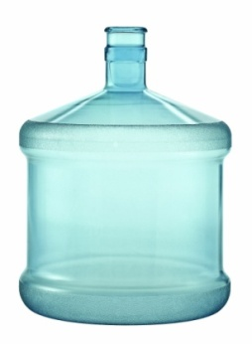
Blind Evaluation
Blinded Product Evaluation:
The evaluation or ratings provided when the product is not identified either through packaging or other labeling.
The purpose of the blinding is to remove from respondent consideration the effect of branding on the product evaluation. This is an attempt to obtain an evaluation that focuses on product characteristics unaffected by the influence of the brand and the image it conveys.
At the end of the questionnaire questions can be added to determine if respondents knew or “guessed” what the product was. This can be used to classify respondents to see if ratings were affected.

Slide 7
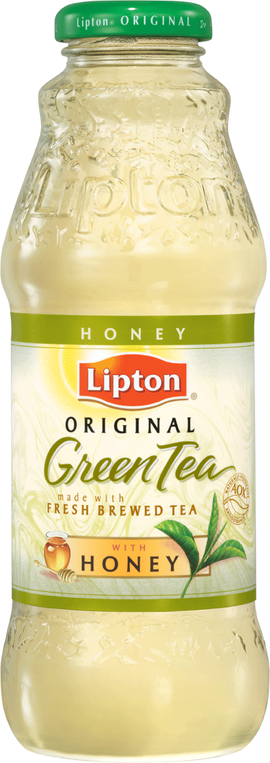
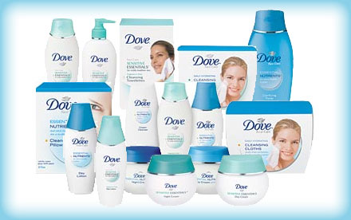
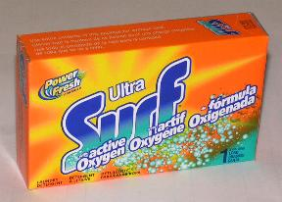
Branded Evaluation
Branded Product Evaluation:
The evaluation or ratings provided when the product is identified or branded, with the intent of allowing the brand and its associated imagery to affect or influence perceptions of the product characteristics as they would do in real-life.
Differences in physical or sensory product characteristics are evaluated in the context of the brand.

Slide 8
Problem Type & Test Design
Branded
Branded
Monadic Test Design
Monadic Test Design
Existing Product Improvement
(including Re-launch)
New Product Development
(including New Variant)
Problem Type
Blind
Branded
Monadic +Sequential
Test Design
Comparative Test Design
Competitor Benchmarking
VIP
Value Improvement

Slide 9
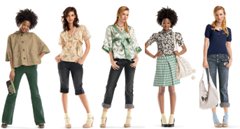

Sample Size and Definition
Sample Definition
Target
Boost/Augment
Sample Size
General rules for Unilever are
Target N=200
Target N= 150 only when:
Early stage product testing
Franchise risk is low
There are no subgroups to be analyzed
Boost/Augment N=100
Example:
18-45 year women
Purchasers of haircare products
Use shampoo least three times a week
Use conditioner at least once per week
Non-rejectors of the Sunsilk brand
Concept acceptors
Straight hair in top three needs
LSM 5+

Slide 10
How many to interview?
Problem Type | Sample Size
Existing Product Improvement | Target N = 200 Interviews per cell
New Product Development | Target N = 200 Interviews per cell
Competitor Benchmarking | Target Monadic N = 200 Interviews per cell
Existing Product Rationalisation | Flexibility/Inter-changeability = 400 Interviews per cell Rationalisation = 250 Interviews per cell Harmonisation = 200 Interviews per cell

Slide 11
Who to interview?
Problem Type | Sample structure
Existing Product Improvement | Brand Users and Non Rejectors
New Product Development | Category Users
Competitor Benchmarking | Category Users (with boosts of users, n= 100)
Existing Product Rationalisation | Brand users (quota’ed a Heavy, Medium, Light buyers/proportioned as per contribution to volume sales (panel data))

Slide 12
Action Standards
Must be Consistent with Brand Performance Standards
Must be agreed by all parties prior to test
CI must be accountable for the action standards
They will depend on what we are trying to achieve/answer…
Statistical superiority vs. control or another product
Parity vs. control product (e.g., Product Rationalisation)
Typically action standards should be set on the following measures using MEAN SCORES:
Overall Opinion
Key product attributes depending on benefits desired (2 – 5 maximum)

Slide 13
Action Standards
Should be set on:
Overall Opinion
Overall measure of the product performance
Key product attributes
Desired product benefits which you want your consumer to perceive and core areas which you want your product to do well on or improve on compared to benchmark.
These should be areas which are critical for decision making.
Should not be set on:
Purchase Intention
As per Unilever guidelines, PI should not be used to set action standards. Reaction to overall opinion and purchase intention have been shown to be closely correlated with overall opinion deemed to be the better measure in a product test environment
Concept-product fit
The concept is used simply to assess whether the product fits with the communication. Concept-product fit is not necessarily a predictor of market success.
Value for Money
No guidelines to say you can’t set AS on VFM, but not recommended as concept not shown in the context of a full market offer, and therefore not an indicator of in-market.

Slide 14
Action Standards – What will drive the business decision?
ACTION STANDARDS SHOULD BE SET ON:
OVERALL OPINION OF PRODUCT AND KEY PRODUCT ATTRIBUTES
WHAT | BUSINESS QUESTIONS | ACTION STANDARDS (GO/ NO GO)
Existing Product Improvement (brand relaunch or formulation improvement but same mix) | Did I improve vs. my Current Product? Have I improved enough to meet the market offer? | SUPERIORITY VS CURRENT
New Product Development (Innovation) | Am I good enough to enter the market offer? | SUPERIORITY VS COMPETITOR
Product Rationalisation | Am I still meeting consumer expectations? | NO LOSSES VS CURRENT
Competitor Benchmarking | Am I better than the competitor? Can my claims be stronger? | SUPERIORITY VS COMPETITOR
Notes:
14
With an Existing Product Improvement:
We would normally want the test product to be rated (significantly) higher than current. This is because there is usually a substantial cost involved in changing the product e.g., R&D costs in developing the product, additional formulation costs, supply chain costs in changing over manufacture from one to the other etc. So in these types of test we want to make sure that the change is ‘worth it’.
With an Existing Product Rationalisation:
We would normally want the test product to be rated the same as / not worse than current (also known as ’parity’). This is because we do not want to alienate our existing buyers by
introducing a product that is worse than the one they are currently using.
With Competitor Benchmarking, there are 2 typical scenarios:
a) we want our product to be rated (significantly) higher than a specific competitor
b) we want our product to be rated the same as / no worse than a particular competitor
With New Products:
It is often quite hard to say what the action standard should be, but here are a few thoughts:
- If you are replacing an existing variant, then you would usually expect the new variant to be rated significantly higher than the variant it is replacing.
- If you are introducing a new brand and you are using a competitor product as a control, you need to decide whether it is good enough to be rated the same as the competitor or whether you need to be rated higher than the competitor.

Slide 15
Using Statistics to set Action Standards
Product Improvement:
Significantly better with at least 95% confidence (two-tailed test)
New Product/Benchmarking:
Statistically significant with at least 95% confidence (two-tailed test)
Rationalisation:
Not significantly worse with 80% confidence (one-tailed test)

Slide 16
Standard Reporting - Action Standard Chart
Action Standard | Action Standard | Measure | Prototype | Current | Prototype vs. Action Standard | Prototype vs. Current
 |  |  | A | B
1. Overall Opinion (Product) | Superiority | Mean | 5.80 | 5.58 | ✓
2. Attribute 1 | Superiority | Mean | 3.97 | 3.81 | ✓
3. Attribute 2 | Parity | Mean | 3.58 | 3.67 | ✗
4. Attribute 3 | Parity | Mean | 4.23 | 4.26 | ✓
✓
Action standards met
✗
Action standards unmet
Statistical “winner” @ 95%
At parity @ 80%

Slide 17
Use of a Control Product
A control product should ALWAYS be included in the test!
Existing Product Improvement (e.g., reformulation, re-launch)
Existing Product Rationalisation
Benchmark ➔ current formulation
New Product Improvement (e.g., new variant)
Competitor Benchmarking
Benchmark ➔ competitor

Slide 18
Product Specifications
It is important to provide the following details on all test packs:
Usage instructions
Ingredients
Any product warnings
Product codes
Packs for placement: always provide between 10 – 20% overage (if F2F); and 30% – 40% for online

Slide 19
Questionnaire Design
Coverage/Process Flow
Standard questionnaires are available for each category and sub-category. Compliance to the globally agreed attributes is critical to drive comparability.
Behavioral/ Purchasing Information (Screener)
Key Measures and Hedonics (i.e. Overall Opinion)
Spontaneous Likes and Dislikes
Specific Attributes (i.e. sensory, functional, emotional) and JARs
Preference
(only for Paired Comparison with VIP/Sequential Monadic )
END

Slide 20
2. Analytic Techniques

Slide 21


Unilever’s Mandate on Drivers Analysis
Macro Level Analysis: Setting Strategy
Analytic approaches and statistical tools that focus on differences or variability between or among multiple products
Factor Analysis ( as drivers within a project)
Bi – Plots
Difference Driver Analysis
Micro Level Analysis: Tactical Guidance
Analytic approaches and statistical tools that focus on data for one specific product
Relative Weight Analysis
Penalty Analysis

Slide 22
Factor Analysis followed by Regression
Macro Level Analysis (Category product drivers only)

Slide 23
Factor/Regression analysis – Factor analysis
Factor analysis first identifies groupings of attributes based on patterns of answering. Factors provide a more reliable base upon which to assess consistency across studies.
Factor 1 – Cleaning results
Attribute | Factor Loading | Percentage
Removes stains in the first wash | 0.86 | 14.5
Cleans clothes thoroughly | 0.82 | 13.8
Removes stubborn stains | 0.82 | 13.8
Cleans well even at low temperatures | 0.78 | 13.2
Cleans well even on shorter washing cycles | 0.77 | 12.9
Keeps whites really white | 0.77 | 12.9
Keeps coloured clothes looking bright | 0.66 | 11.1
Keeps clothes looking new for longer | 0.46 | 7.7
Factor 2 – Value / Convenience
Attribute | Factor Loading | Percentage
Saves time and effort | 0.77 | 27.5
Pack is not messy to use | 0.75 | 26.8
Helps me do my bit for the environment | 0.71 | 25.1
Is economical in use | 0.58 | 20.5
The Factor Loadings are the correlation coefficients between the attributes and the factor. The higher the loading, the stronger the relationship between the individual attribute and the factor.
Percentages of attributes should not be compared across factors as the strength of the relationship to the overall opinion is measured through the % size of the factor
Attributes within a factor are more strongly related to one another than they are to other attributes. Their common theme defines the overall factor.
23

Slide 24
Factor/Regression analysis – Regression analysis
Regression analysis then used to determine the relative influence of each factor on overall opinion of product.
Factor 1 – Cleaning results |  |  |  | 40%
Attribute | Factor Loading | Percentage
Removes stains in the first wash | 0.86 | 14.5
Cleans clothes thoroughly | 0.82 | 13.8
Removes stubborn stains | 0.82 | 13.8
Cleans well even at low temperatures | 0.78 | 13.2
Cleans well even on shorter washing cycles | 0.77 | 12.9
Keeps whites really white | 0.77 | 12.9
Keeps coloured clothes looking bright | 0.66 | 11.1
Keeps clothes looking new for longer | 0.46 | 7.7
Factor 2 – Value / Convenience |  |  |  | 16%
Attribute | Factor Loading | Percentage
Saves time and effort | 0.77 | 27.5
Pack is not messy to use | 0.75 | 26.8
Helps me do my bit for the environment | 0.71 | 25.1
Is economical in use | 0.58 | 20.5
Overall opinion
r²=0.42
r² is the ‘fit’ of the regression model. The higher the r² the more the factors explain variations in overall opinion.
The % shown for each factor is the relative contribution of that factor to overall opinion. The higher the %, the stronger the relationship with overall opinion.
24

Slide 25

Biplots: Assessing performance across products tested
Macro Level Analysis
Products and/or Objects

Slide 26
Brown Bag Sandwich Spread Product Test
Rank order of performance:
Bacon Ranch
Roasted Garlic Parmesan
Country Ranch
Chipotle
Is good on different kinds of sandwiches
Similarly performing products:
All products are fairly differentiated, though the two Ranch products have similar profiles.
Chipotle and Country Ranch are weaker performers overall, while Bacon Ranch and Roasted Garlic Parmesan display above average performance on OL.
Best performer on OL:
Bacon Ranch, as it excels on the attributes most correlated with OL.
Highly correlated attributes:
Attribute vectors that lie near each other
‘Offers something different’ & ‘Good texture/consistency’
‘Whole family would like’ & “Would use regularly’
Is a product you would recommend to friends/family
Chipotle - 1st Recall
Roasted Garlic Parmesan - 1st Recall
Least discriminating attributes:
‘Is a Product you know & trust’, ‘Is a product you would use regularly’, ‘Offers something different from current sandwich spreads’
Most discriminating attributes:
‘Is good on different kinds of sandwiches’, ‘Comes in varieties you like’
Comes in varieties you like
Is made from high quality ingredients
Has many different uses
Is a Product you know and trust
Overall Liking
Offers something different from current sandwich spreads
Is great tasting
Is a product you would use regularly
Is made from premium ingredients
Bacon Ranch- 1st Recall
Seems like it is made from fresh ingredients
Is a product your whole family would like
Has a good texture/consistency
40.8 %
Primary drivers of OL:
‘Is great tasting’, ‘made from premium/high quality ingredients’ ‘has many different uses’
Country Ranch- 1st Recall
55.1 %

Slide 27
Difference Driver Analysis
Macro Analysis; Determining the differences between two products
Notes:
27

Slide 28
How to Visualize Reduction
Product A
Product B
Top Box Overall Rating 46.7% 37.6%
100% Gap
Difference Driver was run and identified the top attribute for improvement:
If Product B improved performance on thickness:
Product A
Product B
Top Box Overall Rating 46.7% 45.0%
81.46% Gap Reduction
Notes:
28

Slide 29
How to Visualize Increase
Product A
Product B
Top Box Overall Rating 46.7% 37.6%
100% Gap
Difference Driver identified top attribute to be maintained for Product B:
If Prod B’s performance declined on “preventing hands from getting wet”…
Product A
Product B
Top Box Overall Rating 46.7% 30.75%
75.23% Gap Increase
Notes:
29

Slide 30
Difference Driver Examples
Notes:
30

Slide 31
Example Using top box Overall Rating Client Product vs. Competitor Product
Issue: The competitive product significantly outperformed the client’s product on top 2 box overall liking. Client wants to know which attributes to focus on to improve their product.
Notes:
31

Slide 32
Example Using top 2 box Overall Rating Test Product X vs. Test Product Y
Issue: Test Product X achieved significantly higher top 2 box overall ratings than Test Product Y. Client wants to understand on which attributes strong performance must be maintained in order for Test Product X to retain its’ strong performance relative to Test Product Y.
Notes:
32

Slide 33
Components of T-Plot
Difference Drivers Analysis is often complemented with
Macro Level Analyses Products and/or Objects
Notes:
33

Slide 34
Control vs. Prototype 1 Example (Top 2 Box Ratings)
The concept significantly outperformed the product on these attributes.
Control
Prototype 1
Notes:
34

Slide 35

Relative Weight Analysis (RWA)
Micro Analysis
Notes:
35

Slide 36
The results must then be examined alongside actual product performance and also compared to macro drivers
SD61 Performance
Weight of Importance Score
Performance based on 5 point mean score
>= 20 Extremely important
>=15 to < 20 Very important
>=10 to < 15 Somewhat important
>=5 to < 10 Not very important
>=0 to < 5 Not at all important
Key drivers of overall opinion across all products tested i.e. important in creating differentiation
Key driver of performance for this product

Slide 37
Penalty Analysis: Revealing the direction for product modification
Micro Level Analysis

Slide 38
What is Penalty Analysis?
A Micro Level analysis (assessment of one product)
Through the use of “just right” scales, it identifies if respondents are giving a product lower overall opinion ratings (penalizing) because it is perceived to have “too little” or “too much” of a specific characteristic
If the answer to the above is yes, the analysis provides guidance on direction for modification
Typical summary output chart for Penalty Analysis
Note: While the typical “just right” scale has 5 points, these scales are collapsed to 3 points to accommodate stable analysis and interpretation

Slide 39
Penalty Analysis Interpretation – “Just Right”
Do ratings qualify as “just right”?
Condition 1
If Just Right % = 75% or more (80% for some clients and categories), then no change required on this attribute
If Just Right is <75%, then a modification may be required.

Slide 40
Penalty Analysis Interpretation: Meaningful Penalties
If not “just right”, follow 3 steps in determining a meaningful skew & penalty:
Skew of approximately 20% or more on either side of the scale
10 percentage point difference between the two skews
Assess associated overall opinion penalty
Step 2
At least a 10% point difference required between the two skews to be able to give clear direction on the modification
Step 3
Size of penalty is evaluated *
Step 1
Skew of approximately 20% or more
*MarketQuest can provide guidelines for identifying meaningful penalties based on number of scale points and summary measure

Slide 41
Penalty Analysis Interpretation - Conclusion Unclear
Sometimes similar proportions of respondents rate a product “too little” as “too much”. Therefore the direction for modification is “unclear”
Similar percentage of respondents indicating ‘not sweet enough’ or ‘too sweet’
Therefore, no clear direction for modification recommendations

Slide 42
Penalty Analysis Interpretation – Penalty Not Meaningful or Positive
Penalty Not Meaningful: Although a meaningful skew (23%) of respondents is rating the characteristic “too weak”, but it does not have a meaningful negative impact on their overall opinion
Falls short of guideline for determining a meaningful penalty on overall opinion
Positive Penalty: Although a meaningful skew (26%) is rating characteristic “not enough”, these respondents have higher overall opinion than those rating the characteristic “just right”
Overall opinion mean among the 26% who indicated ‘not enough’ moisturization is higher than those rating attribute “just right”

Slide 43
3. Guidelines Compliance

Slide 44
ALL deviations from guidelines MUST be approved by UL for Final Consumer Testing (approval is not needed for Early Stage Testing)

Slide 45
What are deviations from the guidelines?
Any requested changes in test design, lower sample size or deviations in the Action Standards versus the guidelines for Final Consumer Testing need to be raised for approval.
Action Standards cannot be set on anything other than what is stated in the guidelines without approval
AS can not be set at parity for new products, line extensions, existing product improvements or benchmarking as they MUST be set at superiority.
They cannot be set to Top 2 Box or cannot be a different LoC than what is stated in the guidelines
Gross negatives must be tested for parity on means at 80% LoC (1 tail t-test)
All final stage testing needs to be In-home not CLT (unless approved)

Slide 46
* For all studies, any exceptions need an approval from the Category VP (CMI) or Senior Director (CTI):
Local UL must email that they have approval for all deviations from the appropriate individual below:
CMI
Chet Henderson – Personal Care
Christina Habib- Refreshment (Ice Cream and Beverages)
Donna Goldfarb- Food
Tomas Emmers- Home Care (Laundry and HHC)
For CTI the local client must seek approval from the CTI Senior Director within the category

Slide 47
Action Standards
Action standards need to be defined on mean score on Overall Opinion AND/OR and 2-3 key attributes
Choice of attributes should be guided by BPS and the objectives of product change
Overall Opinion cannot be the ONLY AS
Too many attributes cannot be set as AS
Example: AS can be set as Superior on Overall Opinion, or one of 2-3 key attributes (and at least parity on the remaining AS)
Note: no gross negatives set to parity on means at 80% LoC (1 tailed t-test)
VIP cannot have any non-preference attributes or monadic questions other than overall opinion, or general usage questions at the end.
Notes:
This chart is fundamental and it sets the context for the rest of the deck.
As we said, we did not believe in a “one size fit all” approach for VIP when we started this journey.
The first column summarises the 3 different VIP project types that we feel confident cover all the different cases across all Categories. The difference from each other lays in the objective we have set at the start and its consumer angle. Lets see each of them:
Flexibility or interchangeability. Definitely the strictest of the 3 types. Main objective here is to maximize flexibility (manufacturing, raw materials, chassis, etc.) through development of alternative options which are so indistinguishable vs. current product, so to enable free switching from one to the other without consumer noticing. Often this happens when we need to qualify alternative suppliers of a raw material/ingredient to maximise flexibility of supply (same spec, different supplier) or when we want to qualify alternative raw materials (slightly different spec). Very common in Laundry. This is the only process that allows a 2 way switch - all others are one directional. This means that consumers can eventually be able to compare the products directly.
Rationalisation. This is probably the most commonly known VIP testing, where we have the objectives to enhance cost efficiencies through value for money options (pack, sensorials, formulation and ingredients reduction) to replace the current.
Harmonisation. This is where we can gain some lea way (allowance for difference), in the sense that here our objective is complexity reduction, i.e. to move from several to fewer formulations/skus, by identifying the alternative from portfolio that is close/closest to current.
In both Rationalisation and Harmonisation, consumers lose the direct comparability to their previous product after a certain moment in time.
From a business perspective, VIP and Flexibility projects have similar scope: margin improvement through formulation changes (new ingredient, new technology, formulation trade-off/reduction).
From a consumer perspective, there is no apparent difference between the 2 value improvement programs since they are both silent moves in the market. However, as we said in one consumer can compare (so we need to ensure there is no perceivable change) in the other ones we can have some lea way…

Slide 48
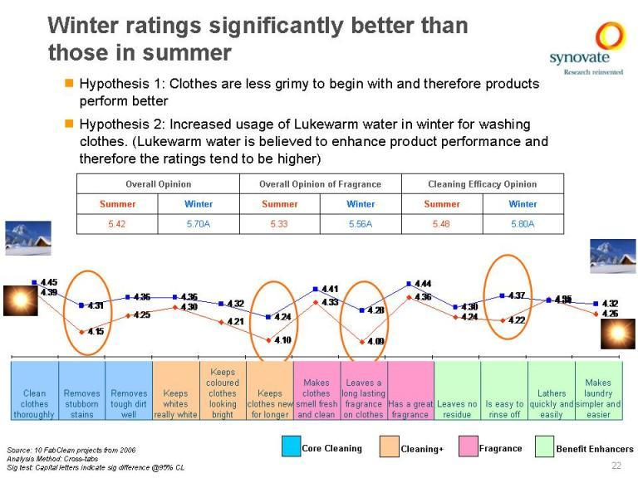
Action Standards
Action standards can be set ONLY against a product tested within the given test
Not vs. concept expectations
Not vs. database
Comparison to only other Unilever products (except benchmarking tests)
Product ratings change dramatically depending on number of factors including seasonality
Notes:
This chart is fundamental and it sets the context for the rest of the deck.
As we said, we did not believe in a “one size fit all” approach for VIP when we started this journey.
The first column summarises the 3 different VIP project types that we feel confident cover all the different cases across all Categories. The difference from each other lays in the objective we have set at the start and its consumer angle. Lets see each of them:
Flexibility or interchangeability. Definitely the strictest of the 3 types. Main objective here is to maximize flexibility (manufacturing, raw materials, chassis, etc.) through development of alternative options which are so indistinguishable vs. current product, so to enable free switching from one to the other without consumer noticing. Often this happens when we need to qualify alternative suppliers of a raw material/ingredient to maximise flexibility of supply (same spec, different supplier) or when we want to qualify alternative raw materials (slightly different spec). Very common in Laundry. This is the only process that allows a 2 way switch - all others are one directional. This means that consumers can eventually be able to compare the products directly.
Rationalisation. This is probably the most commonly known VIP testing, where we have the objectives to enhance cost efficiencies through value for money options (pack, sensorials, formulation and ingredients reduction) to replace the current.
Harmonisation. This is where we can gain some lea way (allowance for difference), in the sense that here our objective is complexity reduction, i.e. to move from several to fewer formulations/skus, by identifying the alternative from portfolio that is close/closest to current.
In both Rationalisation and Harmonisation, consumers lose the direct comparability to their previous product after a certain moment in time.
From a business perspective, VIP and Flexibility projects have similar scope: margin improvement through formulation changes (new ingredient, new technology, formulation trade-off/reduction).
From a consumer perspective, there is no apparent difference between the 2 value improvement programs since they are both silent moves in the market. However, as we said in one consumer can compare (so we need to ensure there is no perceivable change) in the other ones we can have some lea way…

Slide 49
All Final Stage Product Tests should be conducted IN-HOME
Default position – in home study with exceptions being approved by VP (CMI)/ Senior Director (CTI)
Should mimic actual usage and consumption
CLT has several drawbacks including
Unnatural preparation – consumers wont follow instructions at home
Unnatural usage – base to use sauces, family not involved in consumption
Unnatural setting – fragrances from fabric will have to interact with other fragrances at home

Slide 50
Requirements by Category
Agree on
Duration of product placement for each sub-category
Identify any situations where an in-home would not be suitable
Core set of 15 attributes that will be used on all product testing (plus 10-15 custom attributes )

Slide 51
Information Telephone Number to be included
When applicable, Unilever or the Research Agency need to provide an information telephone number that respondent’s can call in case of questions, complaints, etc. The Unilever Care Line has no knowledge of which products we are testing, and whether the consumer is trying out a current or experimental product. You should therefore ensure that there is a contact number available 24/7 in case of consumer issues, questions or complainants.
If you have any non-medical questions or comments regarding this study please call (insert Ipsos phone number) or email (insert Ipsos email address). In case of a medical emergency after using the product itself, please contact your local emergency number or doctor

Slide 52
Mandated Drivers
Mandated Drivers are optional and can either be fully included or completely excluded. However, if the UL project leader is requesting a single or subset of the analyses then approval is required.
For example, if the UL project leader wants RWA on 1 or 2 products in a 4 product test, guidelines state that RWA must be run on each of the 4 products and in addition, biplot, factor analysis, penalty and difference drivers MUST also be included.
UL project leader can either choose to run the FULL set of mandated drivers or to run NO additional analyses without seeking approval.
If the UL project leader wants approval to run RWA on 1 or 2 products they can provide written approval from CMI Category VIP or CTI Director. The approval needs to be sent to Abby Smith.

Slide 53
Power Page Deliverable
The power pages are a mandatory deliverable
The draft of the Power Page (without the CMI / CTI Builds) must be given to the Unilever project leader after the debrief or directly thereafter. Ideally the page should be issued within days of the first presentation of results.
Unilever instituted and distributed the following timing policy that Ipsos must adhere to…
Effective 1 September, 2011 we are asking our Product Testing Agency Partners to issue the One-Page Summaries not later than 3 weeks after the date of the first presentation of findings on a project. If the Unilever CTI / CMI section is not complete, they should issue One-Pager without that commentary.
If you don’t have Unilever’s input by that date, just enter the following in the client sections: “Client input not provided” and send the page as directed.

Slide 54
New Definitions
These new VIP Guidelines now incorporate flexibility and harmonisation initiatives. VIP programs can be broadly classified into three types:
VIP Type | Definition
Flexibility/ Interchangeability | Aims to develop capability to work with different raw materials / suppliers so as to be able to switch back and forth between formulations as cost of goods and/or availability of materials change in the market.
Rationalisation /VIP | Formulation / pack cost reduction that will be implemented as a replacement permanently.
Harmonisation | Seeks to reduce complexity in formulation, SKU, etc. by identifying alternatives that are close to the current and will be implemented as a replacement permanently.

Slide 55

Flexibility
Flexibility may be needed if one supplier cannot produce enough product or cannot have a consistent supply, requiring additional suppliers to be used and consumer switching back and forth between formulations.
This is the only VIP program that allows for a two way switch i.e. from product A to product B and back to product A and hence it is possible for the consumer to experience both products in the marketplace.

Slide 56
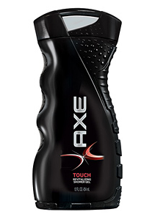
Flexibility Example
Products, locations and other details have been modified for purposes of this example
Situation Analysis:
The Chicago, USA plant is reaching capacity for producing Axe bodywash, and alternative options to ease this issue are being explored. One of which is sourcing body wash from Dresden, Germany.
Objective:
The objective of this study is to determine if the Axe body wash sourced from Dresden is a viable alternative for the current Chicago-sourced body wash

Slide 57

Rationalisation
Much of UL VIP testing falls under rationalisation
Rationalisation seeks to enhance cost efficiencies through reduced cost options across the spectrum of pack, formulation, sensorials, fragrance etc. This could involve a lower level of any of the ingredients or different ingredients leading to a cheaper alternative.

Slide 58
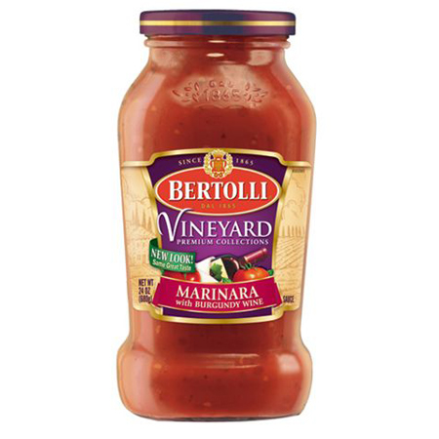
Rationalisation Example
Products, locations and other details have been changed for purposes of this example
Situation Analysis:
The sauce team is looking to remove 5% of the wine in its marinara. Possible characteristics of the VIP that have potential to be noticed by consumers are texture and taste.
Objective:
Evaluate the performance of the reformulated Sauce versus the current among users.
Ensure that the formulation changes do not alienate users.

Slide 59
Harmonisation
Harmonisation seeks to reduce complexity in formulation, SKU, etc. by identifying alternatives that are close to the current and will be implemented permanently.
Harmonisation initiatives could be globalising formulations or functional packaging elements to reduce options down to less, or a single.

Slide 60
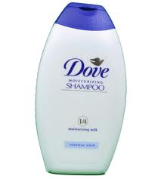
Harmonisation Example
Products, locations and other details have been modified for purposes of this example
Situation Analysis:
The purpose of this project is to discover a common Dove shampoo platform to be used globally.
As there are currently 40 formulations of shampoo globally, the goal is to significantly reduce the number of formulations, which can result in a total savings of approximately 5-10 million Euros.
Objective:
The objective of this study is to determine if no significant differences exist in overall consumer preference between the prototype and the current Dove shampoo in the United Kingdom.

Slide 61
Design of VIP Studies

Slide 62
VIP Test Design Summary
 | Flexibility (Interchangeability) | Rationalisation (VIP) | Harmonisation
Target Group | Brand users of the SKU/variant split into heavy, medium and light in proportion to their contribution of volume.
Blind/Branded | Branded
Test Design | Paired Comparison with two separate product usage periods. Product is rotated so that half of respondents use current first and the other half use VIP first.
Number of Prototypes | Only 1 is recommended
Sample Size | 400 | 250 | 200
Data Collection | In home is standard. Central location upon approval and only if it replicates normal consumption.
Usage Period | Allow for multiple use occasions necessary to assess the product adequately

Slide 63
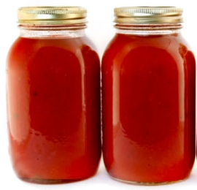
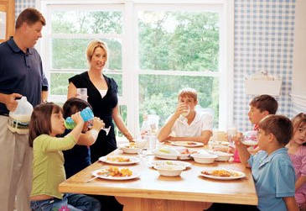
1 final stage branded prototype should be tested In-home Usage is standard. Exceptions need to be approved by UL category VP Allow for multiple use occasions if possible to assess the product adequately
Methodology
Brand X
Brand X

Slide 64


Target Group
The sample should consist of brand users of the SKU/variant split into heavy, medium and light in proportion to their contribution of volume.
Contribution to volume data should be obtained from the Consumer Panel.
Note: the SKU placed should be the variant that has the highest volume within the brand/product or if there is a variant that is expected to have a larger impact from the VIP change that can be tested in addition or instead (depending upon risk level of each variant)
 | Flexibility (Interchangeability) | Rationalisation (VIP) | Harmonisation
Sample Size | 400 | 250 | 200

Slide 65
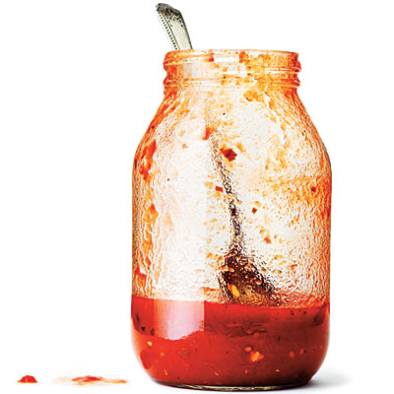
Questionnaire Outline:
Required Screening Questions:
LSM2.0
Brand usage
Frequency of use
Recall 1: Evaluation of product 1
Confirm usage of test product
Overall opinion of product 1 (no additional questions)
Place product 2
Recall 2: Preference, Evaluation of product 2
Confirm usage of test product
Overall opinion of product 2
Preference*
Attribute Preference (can include non-Action
standard attributes)
Optional: general usage questions (not specific
towards only product 1 or product 2)
Half of respondents rate Current Product and half rate VIP Product at recall 1. The reverse is true for recall 2.
* Using NEW 3-pt preference scale: I preferred the product I tried first, I preferred the product I tried second or I have no preference.

Slide 66
VIP FAQ:
Question: Can additional monadic questions be added to a VIP study?
Answer: Yes but they must be asked in the 2nd product recall questionnaire after the Overall Preference and Preference Attribute questions.
Open ends such as reasons for preference can be asked. If you are including product likes/dislikes, or monadic attributes or JARs they should be asked for the 2nd product tried.
It will be harder for respondents to remember details about the 1st product tried so the questions after preference should be asked for the 2nd product tried and you will have results for each product on the half of the sample.

Slide 67
What are the VIP Action Standards?

Slide 68
VIP Action Standard Summary
ALL three action standards need to be met in order to consider a product as meeting the action standards for launch
 | Flexibility (Interchangeability) |  | Rationalisation (VIP) | Harmonisation
1) Preference Action Standard | Overall Preference and Preference on 2-3 key attributes.
Stat Testing on Preference | 2 tail z-test 80% CL No significant difference between % preferring VIP vs. current | 1 tail z-test 80% CL No significant loss on % preferring VIP vs. current
2) Overall Opinion Action Standard | Overall Opinion (monadic rating- this refers to a monadic question but includes 1st and 2nd position data combined*)
Stat Testing on Overall Opinion | 2 tail t-test 80% CL No significant difference on mean score of VIP vs. current | 1 tail t-test 80% CL No significant loss on mean score of VIP vs. current
3) Alienation Action Standard | Among those who preferred each product compare B3B Overall Opinion
Stat Testing on Alienation | 1 tail z-test 90% CL
*Note: 1st position monadic ratings must be checked to ensure they are inline with the combine
d position results.

Slide 69
Alienation Calculation
(a) Determine B4B (as % of total sample) of VIP for those preferring current
(b) Determine B4B (as % of total sample) of Current for those preferring VIP
The action standards are that (a) should not be significantly larger than (b) using 1 – tailed z- test @ 90% confidence level.
For calculating alienation, consumers who mention “no preference” are not included.

